Slide 1

Sky High Tech
Code Fest-2023
Coding Contest
(Junior)

Slide 2
Sky High Tech
Code Fest-2023
Coding Contest
(Junior)
A/ Mihinthale National College

Slide 3
Sky High Tech
Sky High Tech
Code Fest-2023
Coding Contest
(Junior)
Code Fest-2023
Coding Contest
(Junior)
A/ Mihinthale National College
Teacher Name
E.M.S.D.De Seram
Contact Number
0771803561
Email
sunali123456@gmail.com

Slide 4
Achintha Udana (Leader)
078 833 0434
dragonhunter1977820@gmail.com
Teacher Name
A.N.S. Gunarathna
Contact Number
070 273 6237
Email
gunarathnashanika@gmail.com
Jenith Oshadha
078 627 9894
jenithk01@gamil.com

Slide 5
Email
sunali123456@gmail.com
Contact Number
0771803561
Teacher Name
E.M.S.D.De Seram
Nimsara Shanaka
076 891 7608
nimsarashanaka365@gmail.com
Achintha Udana (Host)
078 833 0434
achintha200932@gmail.com
Jenith Oshadha
078 627 9894
jenithk01@gamil.com
Chamath Nerangana
071 467 9835
achintha200932@gamil.com

Slide 6
Achintha Udana (Leader)
078 833 0434
dragonhunter1977820@gmail.com
About This
Nimsara Shanaka
076 891 7608
nimsarashanaka365@gmail.com
Benefits of our website
Minusha Nilupul
078 300 5234
minushanilupul248@gmail.com
Discover limitless learning opportunities at Sky High Tech. Access expert-curated courses, engaging content, and interactive tools anytime, anywhere. Unleash your potential and learn at your own pace, all from the convenience of your device.
Jenith Oshadha
078 627 9894
jenithk01@gamil.com

Slide 7
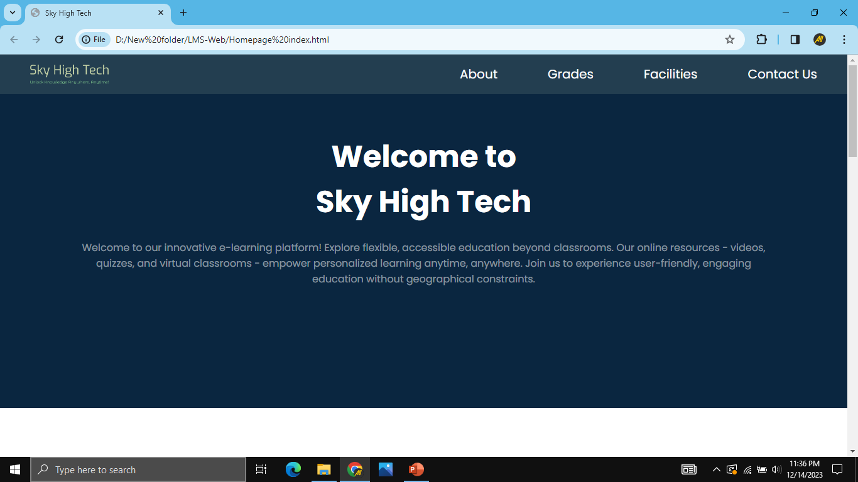
About This
Discover limitless learning opportunities at Sky High Tech. Access expert-curated courses, engaging content, and interactive tools anytime, anywhere. Unleash your potential and learn at your own pace, all from the convenience of your device.
Nimsara Shanaka
076 891 7608
nimsarashanaka365@gmail.com
Chamath Nerangana
071 467 9835
achintha200932@gamil.com
Title
Headline
Navigation Bar
Paragraph

Slide 8
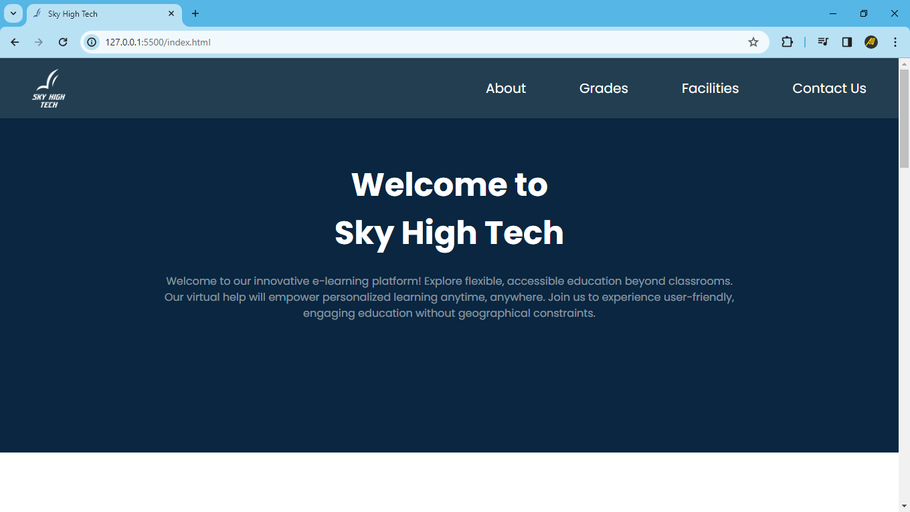

You can always use this
This is easy to use
You can download textbooks from here
You can save time by using this
You can get a idea about our school
If you have any problem you can contact us
Title
Headline
Navigation Bar
Paragraph
About This

Slide 9
Title
Title
You can always use this
This is easy to use
You can download textbooks from here
You can save time by using this
You can get a idea about our school
If you have any problem you can contact us
Headline
Navigation Bar
Paragraph
You can watch lessons and download text-books by using this tab
About This

Slide 10
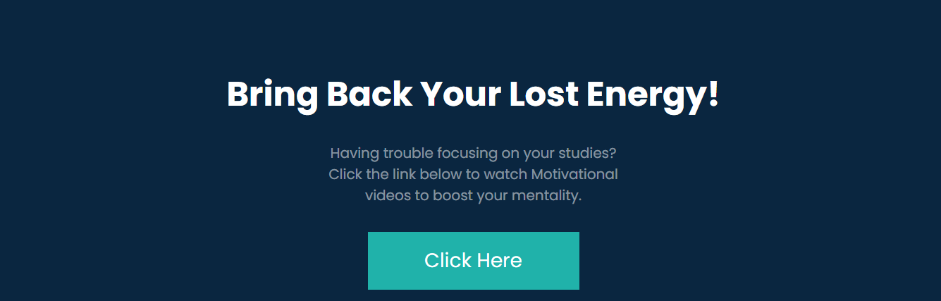
Title
You can always use this
This is easy to use
You can download textbooks from here
You can save time by using this
You can get a idea about our school
If you have any problem you can contact us
Headline
Navigation Bar
Benefits of Sky High Tech
Benefits of our website
Paragraph
Benefits of Sky High Tech
Benefits of Sky High Tech
Watch Motivational Videos From This Button
About This
Benefits of Sky High Tech

Slide 11
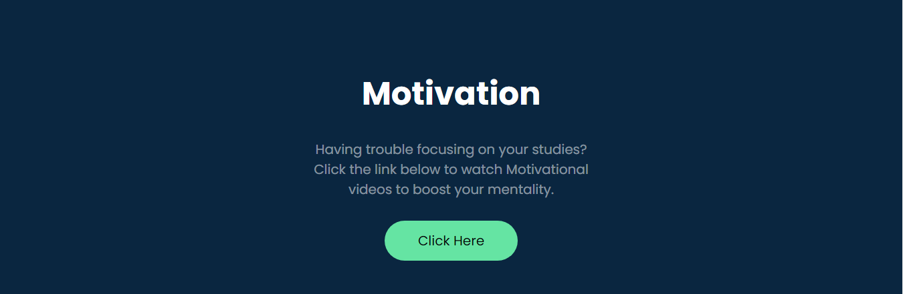
Watch Motivational video from this button
Benefits of Sky High Tech
Watch Motivational video from this button
You can always use this in anywhere.
This is easy to use.
You can download textbooks and get the link of the lessons.
You can save time by using this.
If your are in a problem, you can watch a motivation video from here.
If you have any problem you can contact us.
Access from anywhere.
Easy to use.
Free download or watch lessons and text books.
Saves you time.
If you feel tired, you can watch a motivation videos from here.
24X7 Technical support.

Slide 12
Benefits of
our website
Benefits of our website
Benefits of Sky High Tech
\
Thank You
About This
Access from anywhere.
Easy to use.
Free download or watch lessons and text books.
Saves you time.
If you feel tired, you can watch a motivation videos from here.
24X7 Technical support.
Thank You.
Discover limitless learning opportunities at Sky High Tech. Access expert-curated courses, engaging content, and interactive tools anytime, anywhere. Unleash your potential and learn at your own pace, all from the convenience of your device.

Slide 13
You can always use this in anywhere.
This is easy to use.
You can download textbooks and get the link of the lessons.
You can save time by using this.
If your are in a problem, you can watch a motivation video from here.
If you have any problem you can contact us.
Benefits of
our website
Access from anywhere.
Easy to use.
Free download or watch lessons and text books.
Saves you time.
If you feel tired, you can watch a motivation videos from here.
24X7 Technical support.
Benefits of our website
About This
Thank You.

